Slide 1

D.K.T.E. SOCIETY'S TEXTILE AND ENGINEERING INSTITUTE, ICHALKARANJI
MERN Stack Development — Internship Training
Department of Computer Science & Engineering | Artificial Intelligence and Machine Learning | Academic Year: 2025–2026
An Autonomous Institute, Affiliated to Shivaji University, Kolhapur | Accredited with 'A+' Grade by NAAC
Under the guidance of Prof. Snehal Jadhav

Slide 2
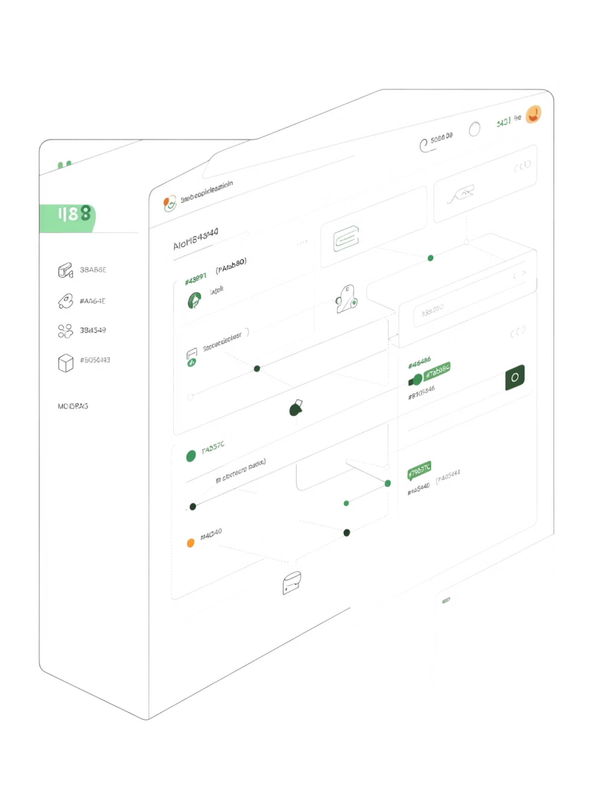
Introduction & Problem Statement
The Student Learning Platform is a full-stack SPA developed during a one-month internship at Sunbeam Infotech, Pune. It bridges the gap between educational administrators and students, providing a centralized environment for course discovery, enrollment, and video-based content delivery. Built on MERN-inspired stack — React.js (Vite), Node.js + Express.js, and MySQL — with JWT-based role-based access control.
Manual & Fragmented Records
Student enrollments managed manually, making tracking inefficient and error-prone.
No Centralized Content Platform
No single system for students to browse, enroll, and access video lectures.
Unprotected Content Distribution
Premium video content at risk of leakage without secure, enrollment-based access.
Lack of Role-Based Access
No mechanism to separate admin operations from student-facing features.

Slide 3
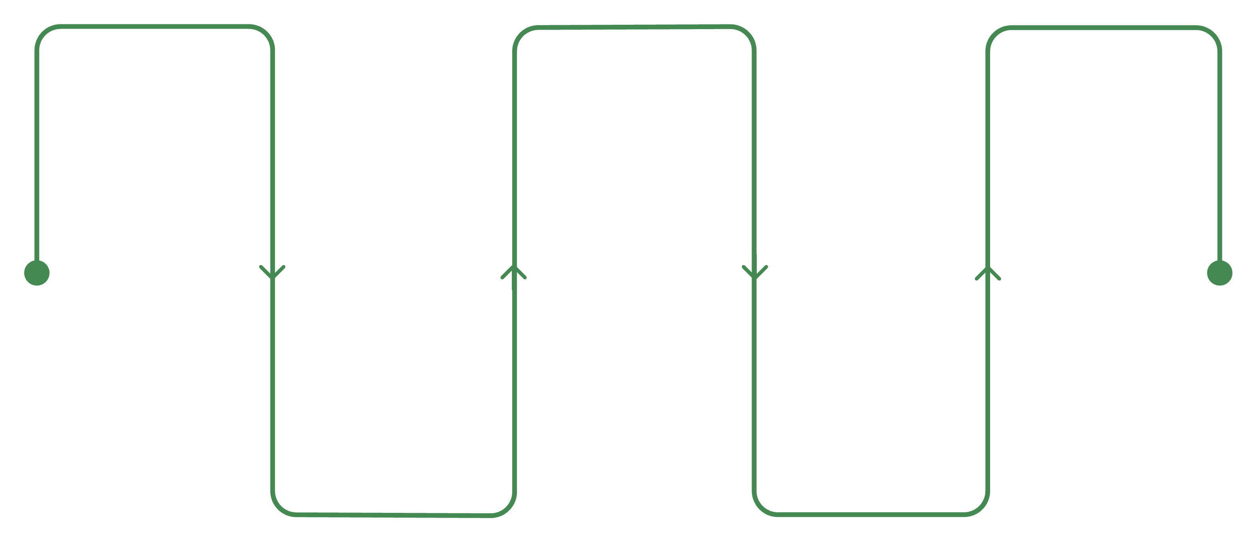
Problem Solution & Development Steps
A full-stack SPA was developed to unify course management, enrollment, video delivery, and user data into a single automated framework. Core solutions include RBAC with distinct admin/student interfaces, JWT authentication for stateless session management, video access expiry via configurable windows, and a structured MySQL schema with proper Foreign Key relationships.
Requirements
Backend
Testing
Build Node.js + Express REST APIs
Validate APIs with Postman
Gather needs and plan scope
Database
Frontend
Design MySQL schema with 4 tables
Integrate React.js and manage state
The team adopted an incremental approach — designing the database schema first, building backend APIs next, and finally integrating the React frontend. Each module was independently tested using Postman before integration.

Slide 4
Tools Used & Technologies
Core Tools
Technology Stack
MySQL — Relational database (sunbeam1) with four tables (users, course, student, videos) and Foreign Key constraints ensuring data consistency.
Frontend
Backend
React 18 (Vite), React Router DOM, Axios, React Toastify
Node.js, Express.js, JWT middleware (authUser), CORS, mysql2 pool
Postman — API testing tool used to send HTTP requests with/without JWT tokens, validate responses, and resolve backend issues (500 errors, connection failures, token authorization failures).
Database
MySQL — users, course, student, videos tables with FK relationships

Slide 5
Working Methodology & About the Project
The platform operates on a Stateless System Architecture — the React.js frontend communicates with the Node.js/Express.js backend via JSON REST APIs, which interact with the MySQL database. The server maintains no user sessions; every protected request must include a valid JWT token in the header.
Admin Module
Student Module
Accessible exclusively to admin-role users. Provides complete course and video lifecycle management — add, update, delete courses and videos, configure video expiry settings per course, and view all enrolled students.
Students browse active courses, register with basic details (name, email, mobile), access enrolled courses via 'My Courses', watch YouTube-embedded lectures, and manage their profile. The React frontend dynamically switches layout based on the authenticated user's role.

Slide 6
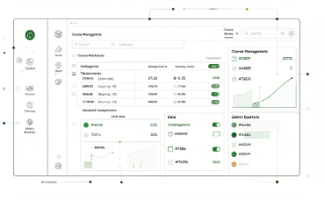


Output Delivered & Conclusion
For Administrators
For Students
Full course management dashboard (add/update/delete with fees, dates, expiry settings), video management panel with YouTube URLs, and real-time enrolled students list.
Responsive course catalog with details, self-enrollment form, secure 'My Courses' dashboard with YouTube-embedded lectures, and profile management with password change.
The platform successfully modernizes the coaching institute experience using React.js (Vite), Node.js, Express.js, MySQL, and JWT authentication. Future enhancements include payment gateway integration, bcrypt password hashing, per-student video progress tracking, and cloud deployment.

Slide 7
About Our Roles
Four specialized roles ensured efficient full-stack development and delivery.
Tahir Handimalik — Backend Developer
Shubham Davari — Tester & Deployment Specialist
Built Node.js/Express.js REST API server, all endpoints (auth, courses, videos, students, admin), JWT middleware (authUser), video expiry logic via DATEDIFF, and MySQL connection pool.
Comprehensive Postman API testing, simulated HTTP requests with/without tokens, resolved 500 errors and JWT failures, managed local deployment (npm start port 4000, npm run dev).
Sarthak Katkar — Frontend Developer
Pratik Jadhav — Database & Security Admin
Built complete SPA in React 18 (Vite) — student pages (Home, Course Info, Enrollment, My Courses, Video Player, Profile) and admin pages (Dashboard, CRUD for courses/videos, Enrolled Students). Integrated Axios and React Router DOM.
Designed MySQL schema (sunbeam1) with users, course, student, videos tables and FK constraints. Managed ENUM role field, video_expire_days column, JWT authentication, and CORS middleware.

